Slide 1
Installing SourceTree
Gregory Brunner

Slide 2
SourceTree
The app we will use to interface with GitHub
Allows us to visualize all aspects of source control
It’s free!

Slide 3
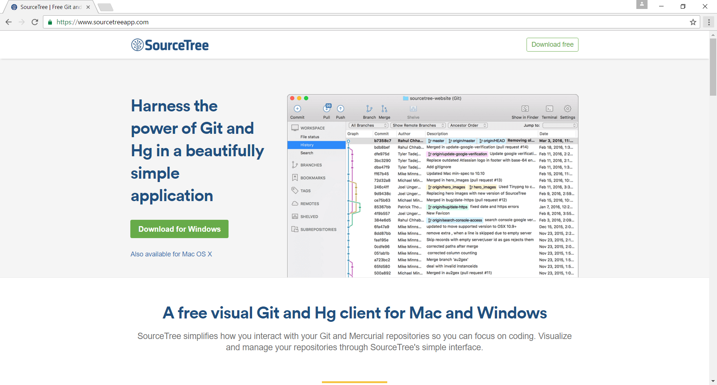
1. Go to www.sourcetreeapp.com

Slide 4
2. Download the app (it’s free!)

Slide 5
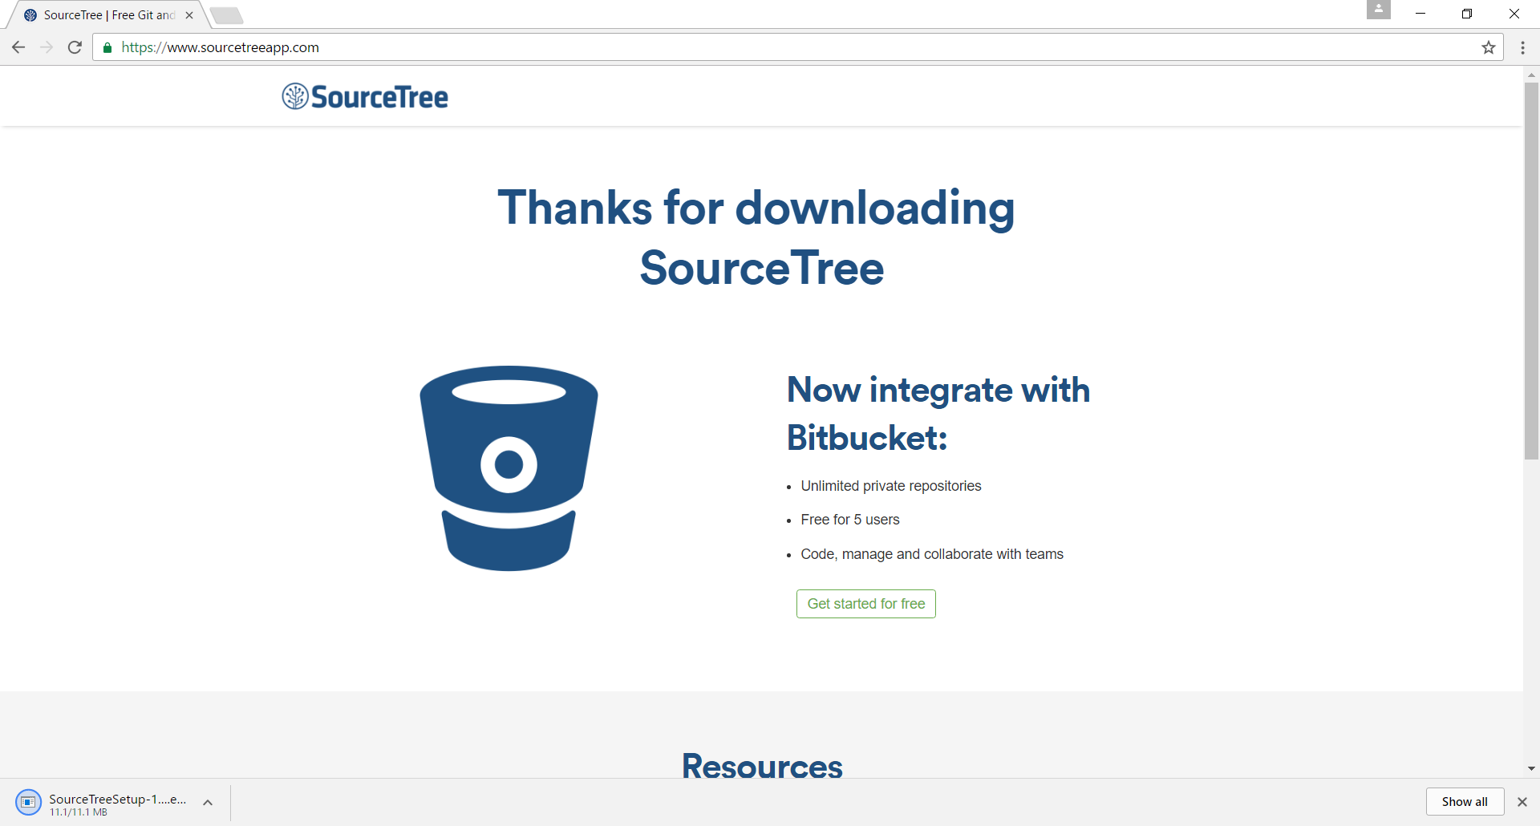
This is what you should see after you start downloading the app

Slide 6
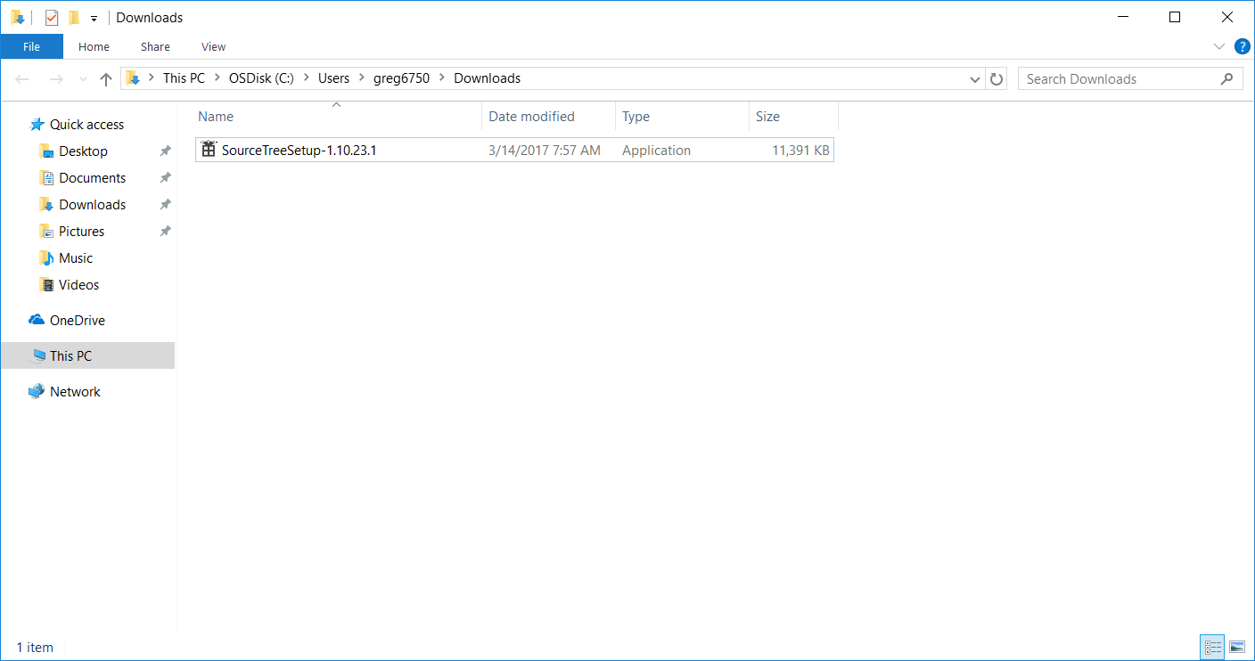
3. Install the app

Slide 7
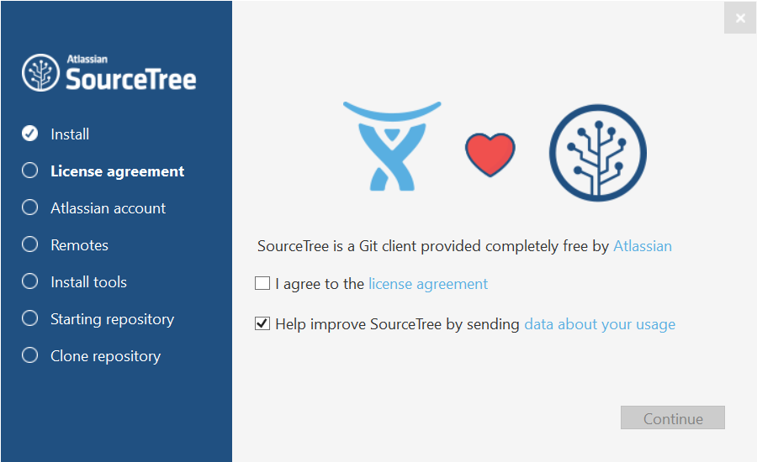
This is what you should see when you start installing the app

Slide 8
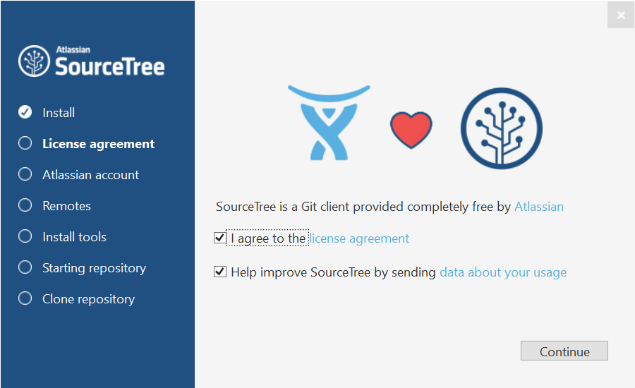
4. Agree to the license agreement

Slide 9
5. Click “Continue”

Slide 10
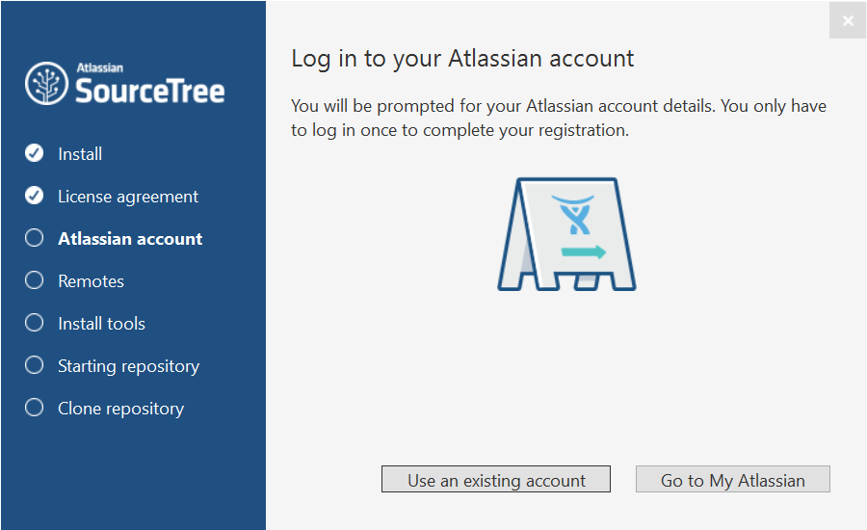
6. If you don’t have an Altassian Account, create one by clicking
“Go to My Atlassian”

Slide 11
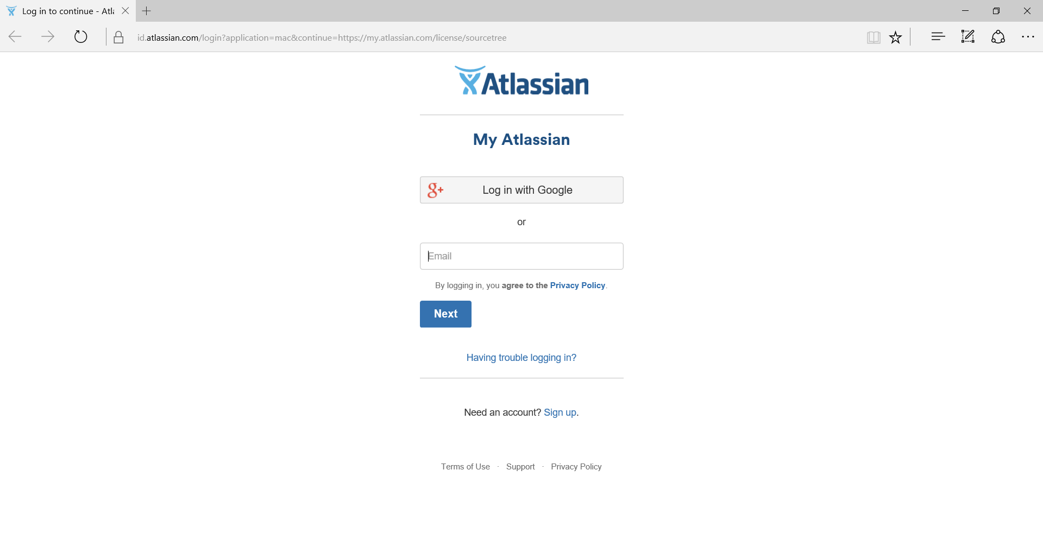
7. If you don’t have an account create one.

Slide 12
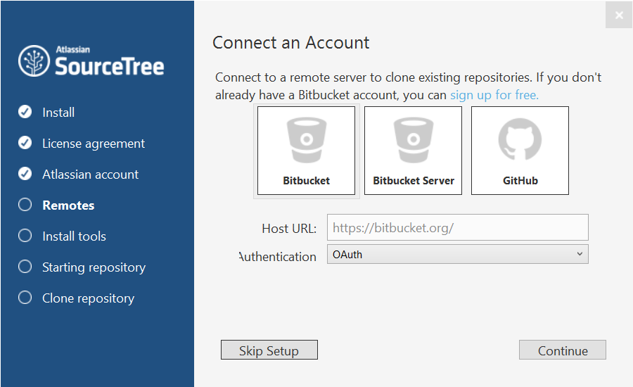
8. You should get to this screen after creating an account

Slide 13
9. Skip this setup

Slide 14
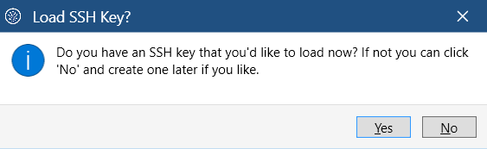
10. You udo not have an SSH key, click “no”

Slide 15
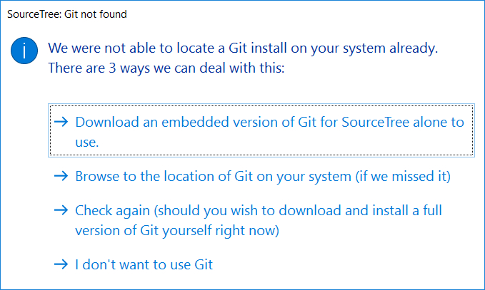
11. Download an embedded version of Git for SourceTree when prompted

Slide 16
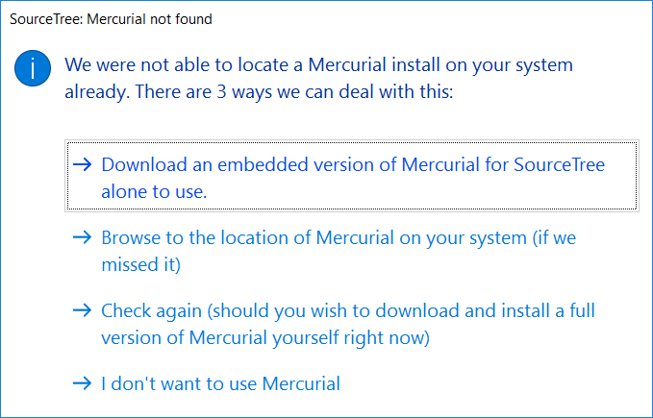
12. Download an embedded version of Mercurial for SourceTree when prompted.

Slide 17
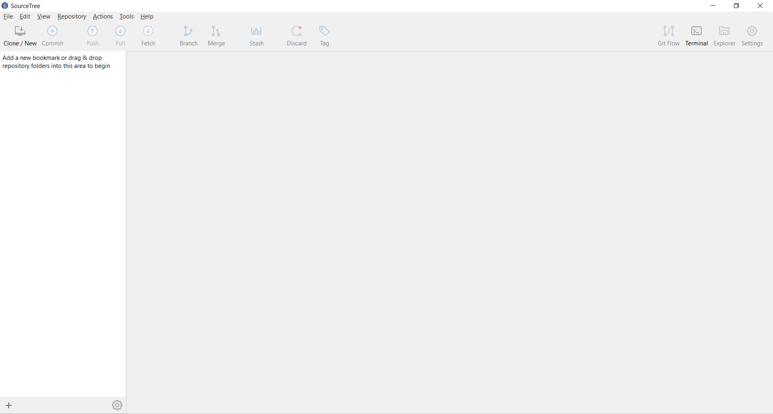
SourceTree is Installed!
That should be it!

